Slide 1

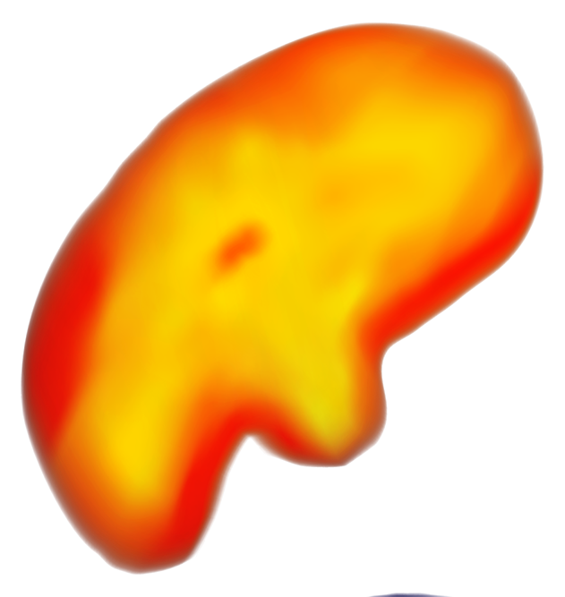
Predicting Tornadoes
Joe Ortiz
Austen Radigk
Milo Dufresne-MacDonald

Slide 2
Data Overview
68,868 tornadoes from 1950 - 2021
Temporal Data
Geographic Info
Tornado Characteristics
Date
Time Zone
Time
State
Starting Longitude/Latitude
Ending Longitude/Latitude
State FIPS Numbers
Total State(s) Affected
EF-Scale
Injuries
Fatalities
Estimated Property Loss
Estimated Crop Loss
Length (mi)
Width (yd)

Slide 3
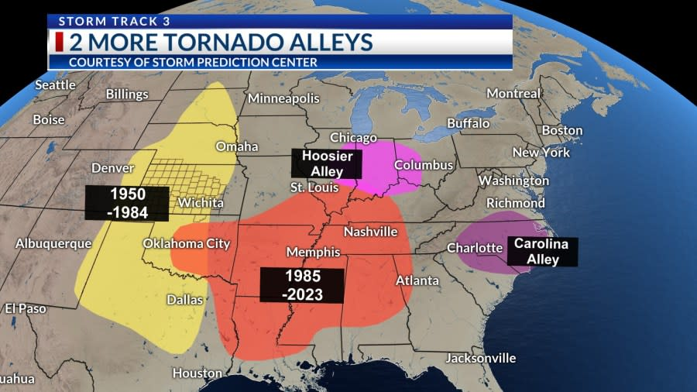
Where do they occur?
Tornado Alley
Loosely defined geographical location of the Central United States where tornadoes are the most frequent.

Slide 4
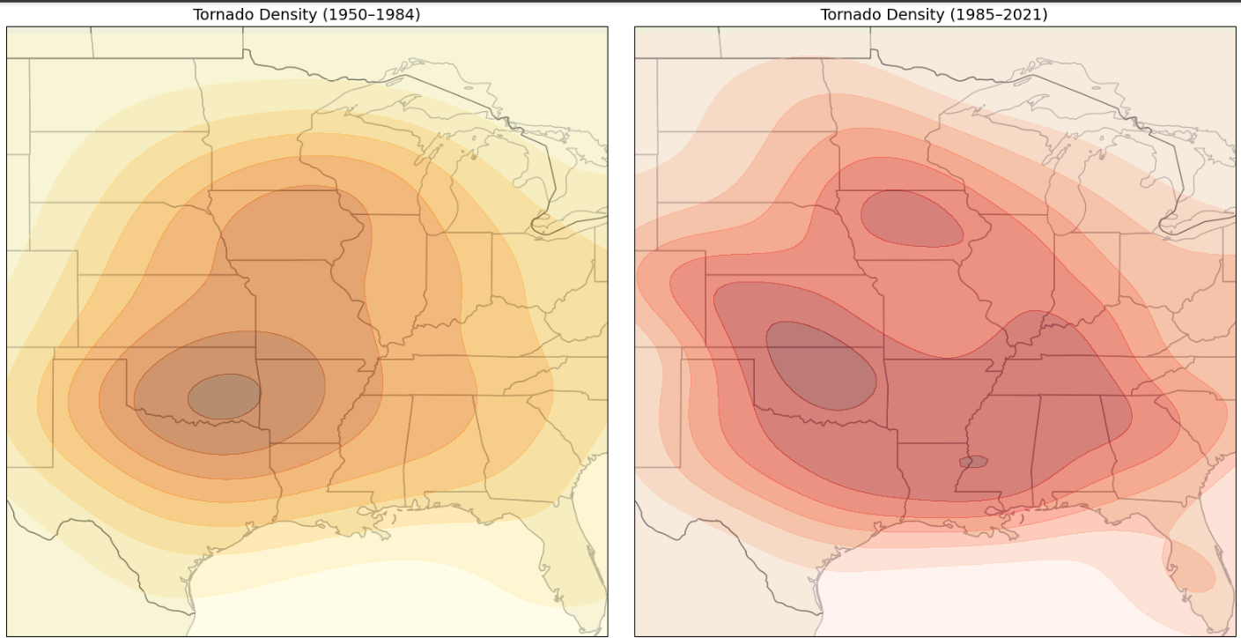
Where do they occur?
Tornado Alley
Loosely defined geographical location of the Central United States where tornadoes are the most frequent.

Slide 5
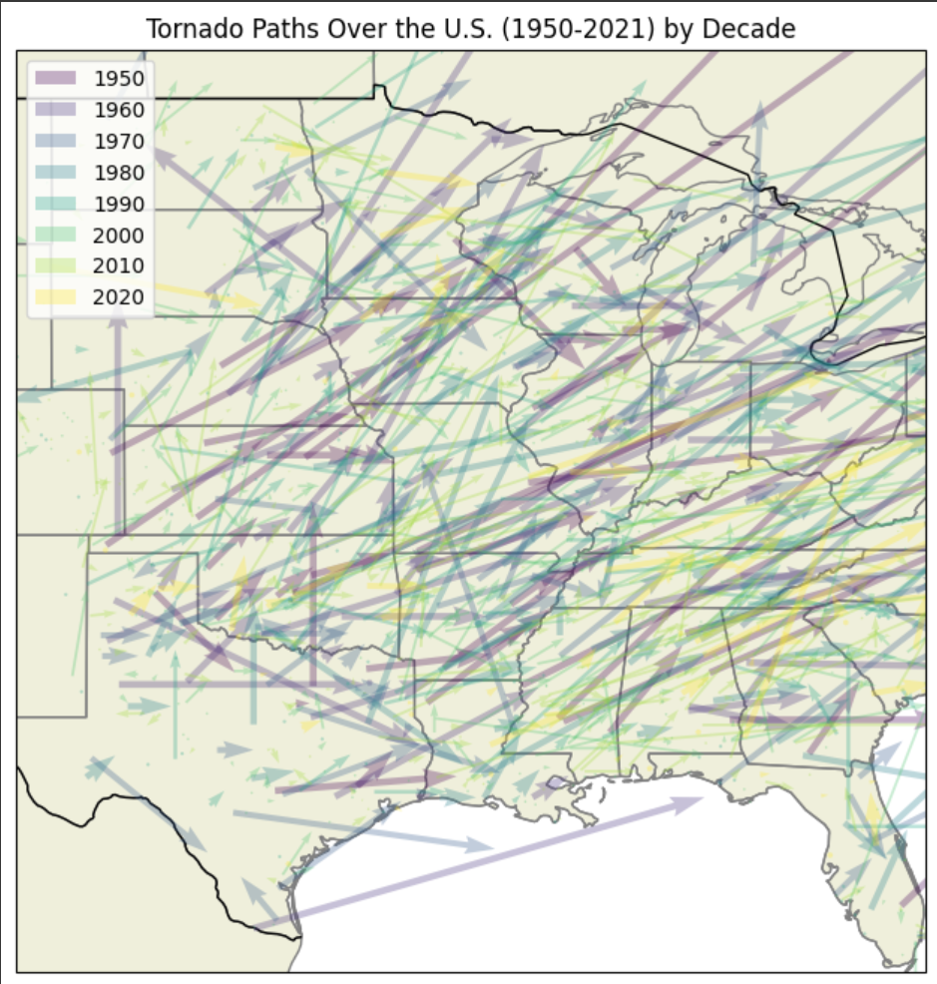
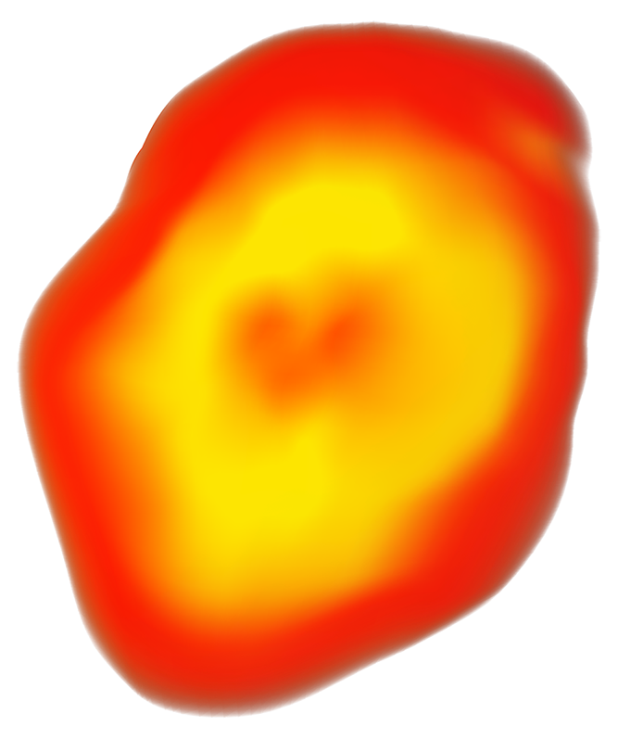
Tornado Paths
1950 - 2021
Notes:
Historically, we know where tornadoes typically occur, so our next steps were verifying if our data followed similar trends. Here we’ve plotted every 30th tornado in our dataset by it’s starting and ending longitude and latitude to visualize tornado paths. We chose every 30th tornado to reduce visual clutter from the plot but trends remained consistent when grabbing different intervals of data points.
As we would expect, tornadoes are traveling from the southwest to the northeast, which aligns with the previous visualization we saw.

Slide 6
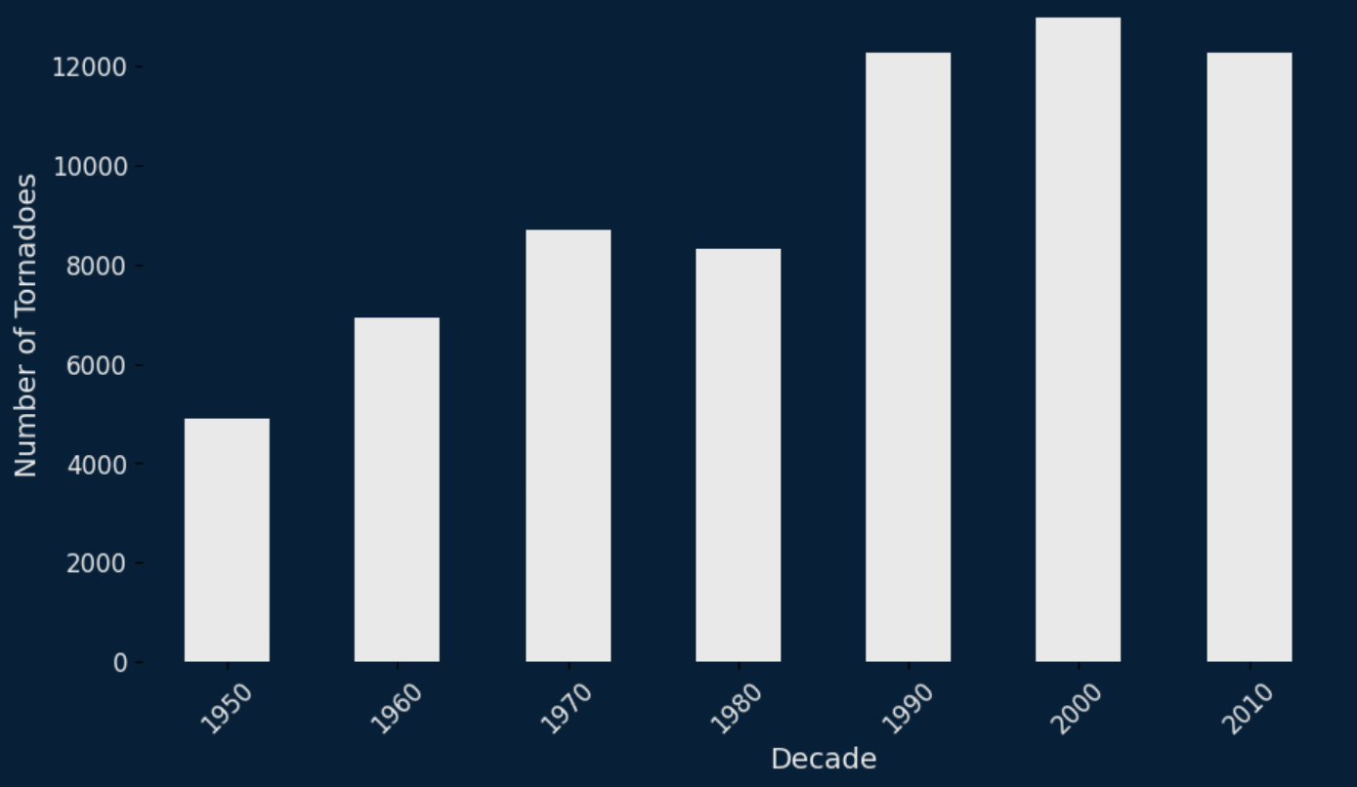
Tornado Distribution by Decade
Notes:
But simply plotting where tornadoes are beginning and ending doesn’t give us a whole lot of information about the relative frequency of tornadoes across our dataset. Here we have just a simple count of storms that occurred within different decades in our dataset. Because our data does not extend beyond 2021, information for the 2020 decade is sparse but regardless, we see an increasing count of tornadoes as we progress.
Now, it would be misleading to just assume this trend is because more tornadoes are happening. Realistically, technology for detecting tornadoes has improved remarkably since the 50s and some data even points to the idea that tornadoes have been decreasing since data collection began.
PROJECTED TORNADOES FOR 2020 = 12,345 (2469 in 2020 + 2021. 2469/2 = 1234.5 * 10 = 12,345)

Slide 7

How are tornadoes measured?
The Enhanced Fujita Scale (EF Scale) is based on:
Estimated Wind Speeds
Related Damage
Tornado damage is compared to Damage Indicators and Degrees of Damage to better estimate the range of wind speeds the tornado likely produced.
Source: https://www.weather.gov/oun/efscale
Notes:
Now let’s get a little more granular and explore how different EF-ratings are represented within our dataset.
National Weather Service uses the Enhanced Fujita scale to estimate the strength of tornadoes. This scale is based on estimated wind speed and the related damage caused by these winds. Wind speed is based on 3-second gusts and essentially, trained persons identify damage indicators in the tornadoes path (so buildings, municipal infrastructure, trees, etc.) and then determines a degree of damage that matches the damage indicator being considered. So if they’re looking at buildings, were roofs ripped off. If talking about infrastructure, are lamp poles broken or leaning. On trees, are branches broken or splintered.
Based on the amount of damage seen in a tornadoes path, the national weather service estimates the wind gusts necessary to produce that level of damage. This is then how we reach the final EF-scale measurement we’re familiar with

Slide 8
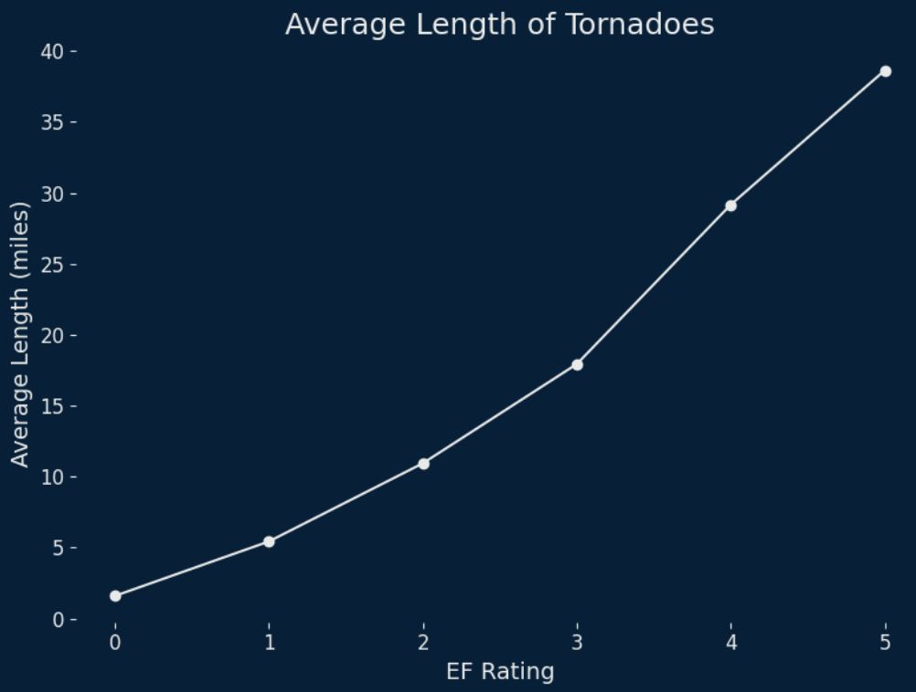
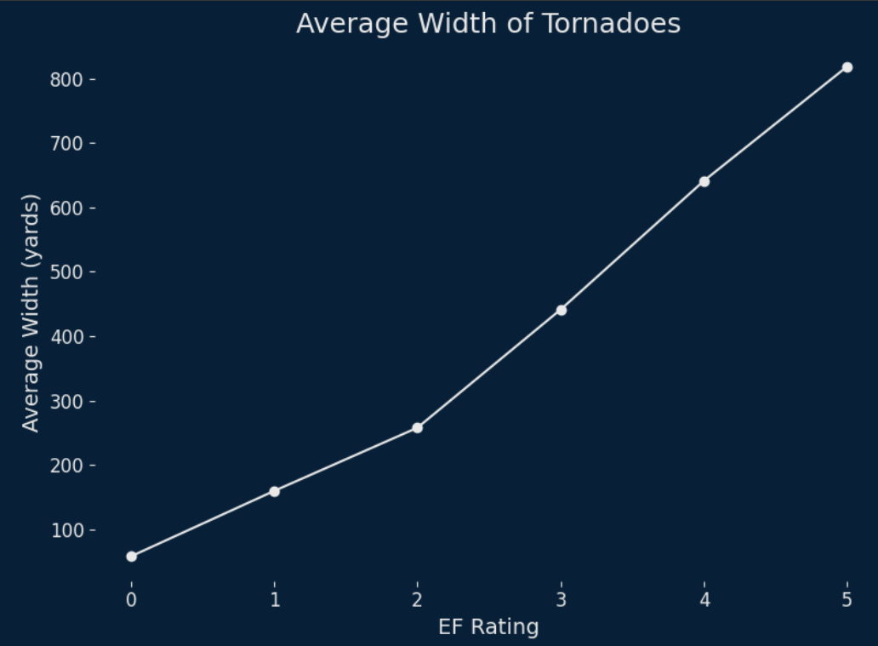
Tornado Metrics
Average Length - 5.56 mi Average Width - 150.65 yd
Notes:
Average length and width of tornadoes in dataset. Then break it up into different EF-Scales and discuss how it aligns with the expected values in the EF-Scale documentation

Slide 9
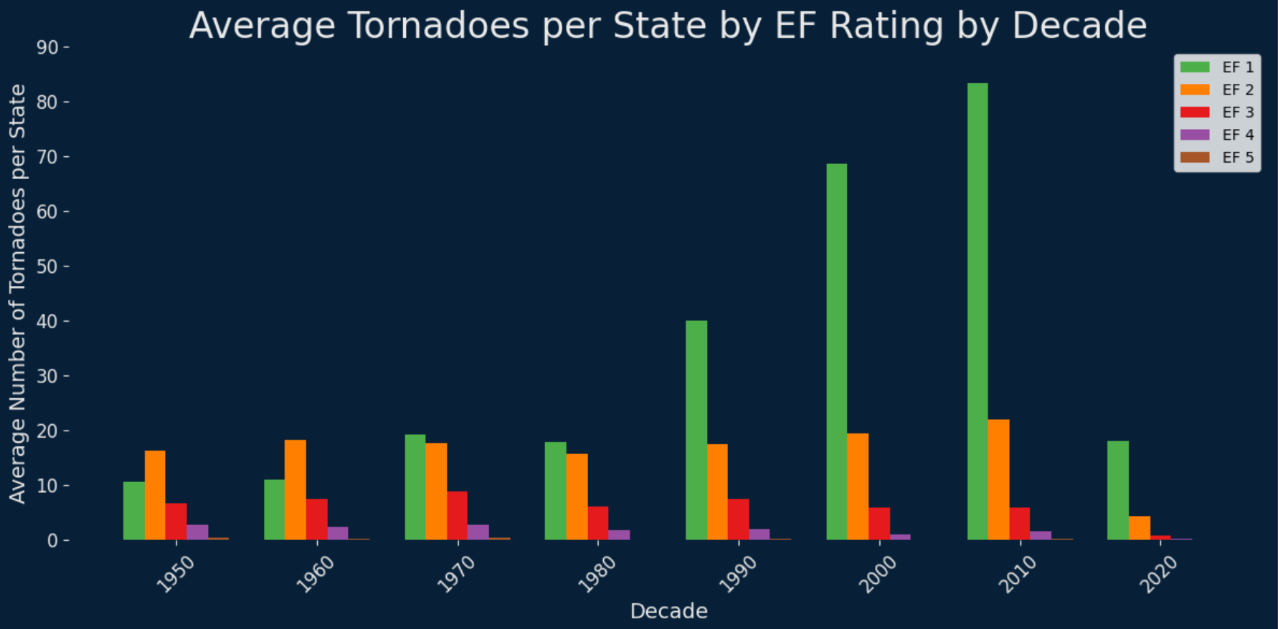
EF-Ratings by Decade
Notes:
Here we have tornadoes broken up by magnitude now that we understand how tornadoes are measured. We can clearly see that EF 1 tornadoes are the most common, which shouldn’t be surprising. With how many tornadoes the southwest United States sees, it would be realistic to expect every tornado to be massive, destructive storms of the EF 4 and 5 variety. This graph here tells us that our models should be biasing weaker tornadoes, especially EF 1 ratings.

Slide 10
Modeling Objectives
Focusing on EF1 - EF4
EF5 → Unused due to improvements in technology.
EF0 → Difficult to detect.
What characteristics can be used to predict tornado severity?
What are the features of tornadoes that cause damage?
What features make a tornado violent?
How do tornado characteristics differ between EF-ratings?
What features are different between the majority of all damaging tornadoes and violent tornadoes?

Slide 11
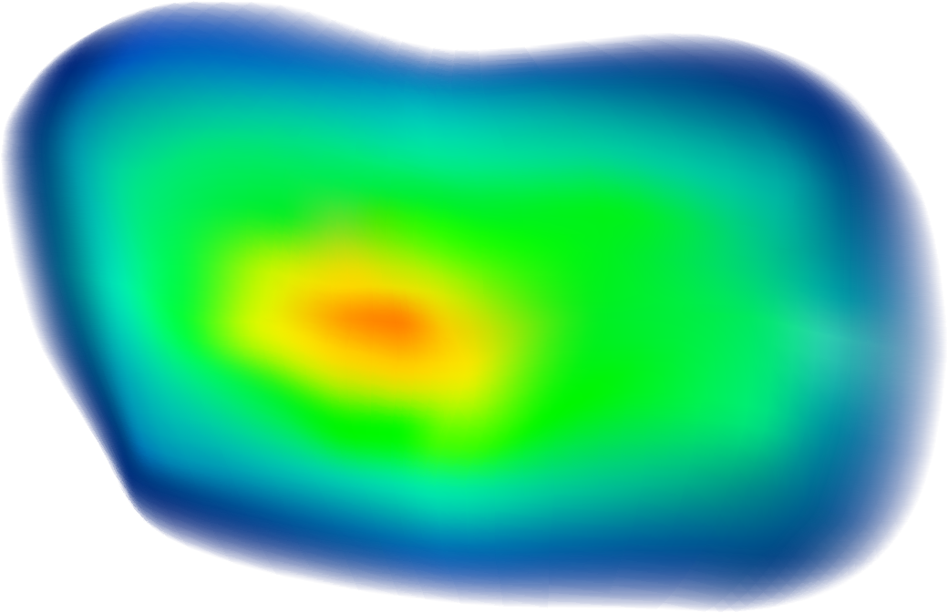
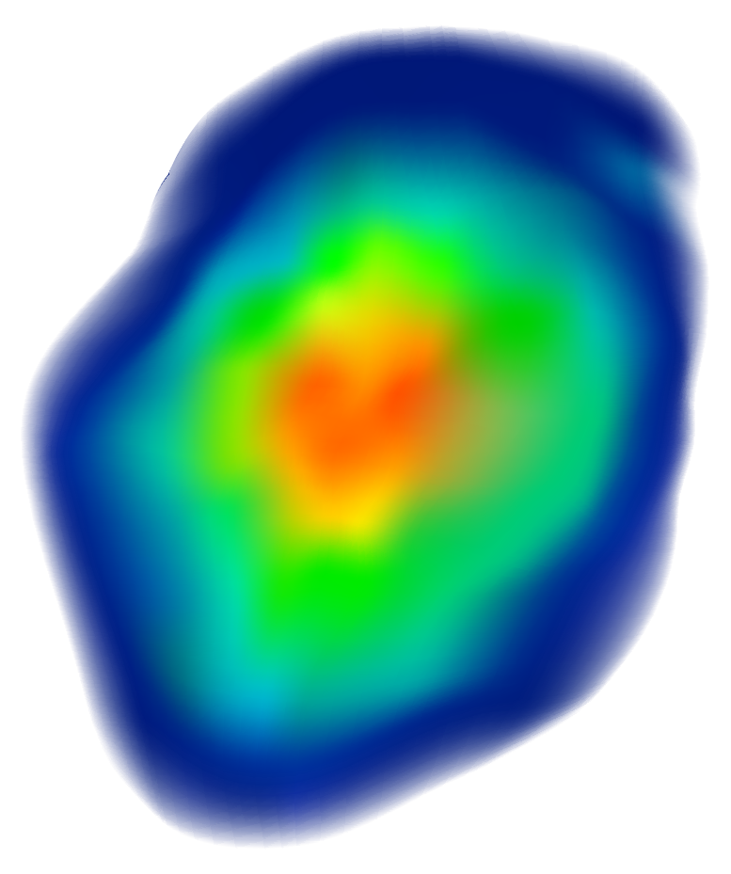
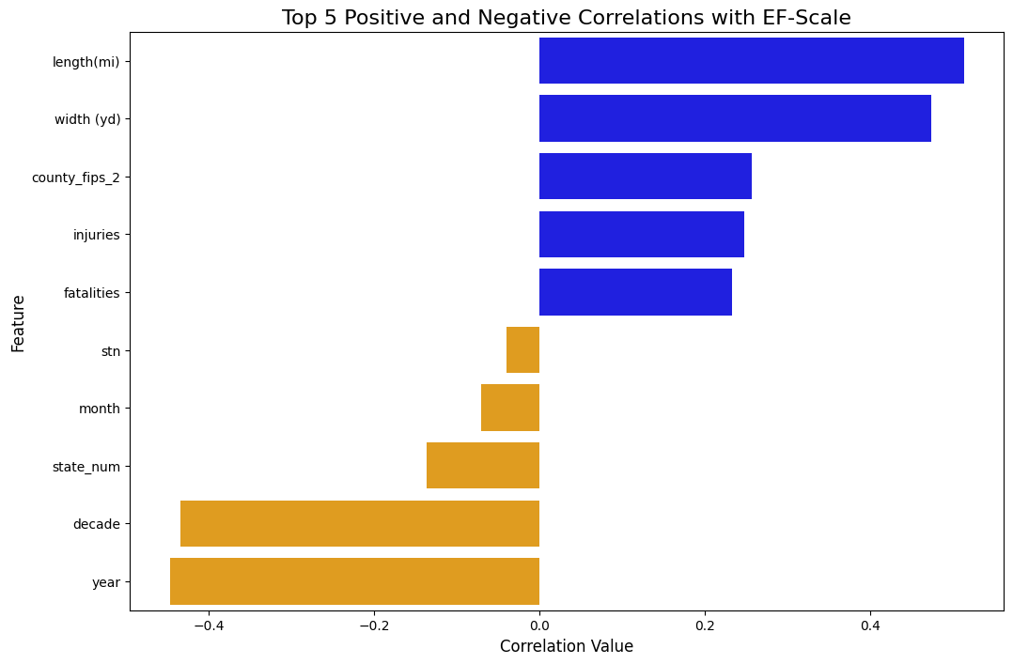
EF Scale Correlations
Notes:
Here are the general trends seen in this data
The Length and Width are Important for Determining a Tornado's Strength / Rating
It also a appears the year has a important role in Terms of a Tornado's Rating
There are a few reasons for this

Slide 12
Predicting Non-Violent Tornadoes
EF1 and EF2 Ratings
Notes:
EXPLAIN WHY WE GROUPED TORNADOES TOGETHER IN THIS WAY

Slide 13
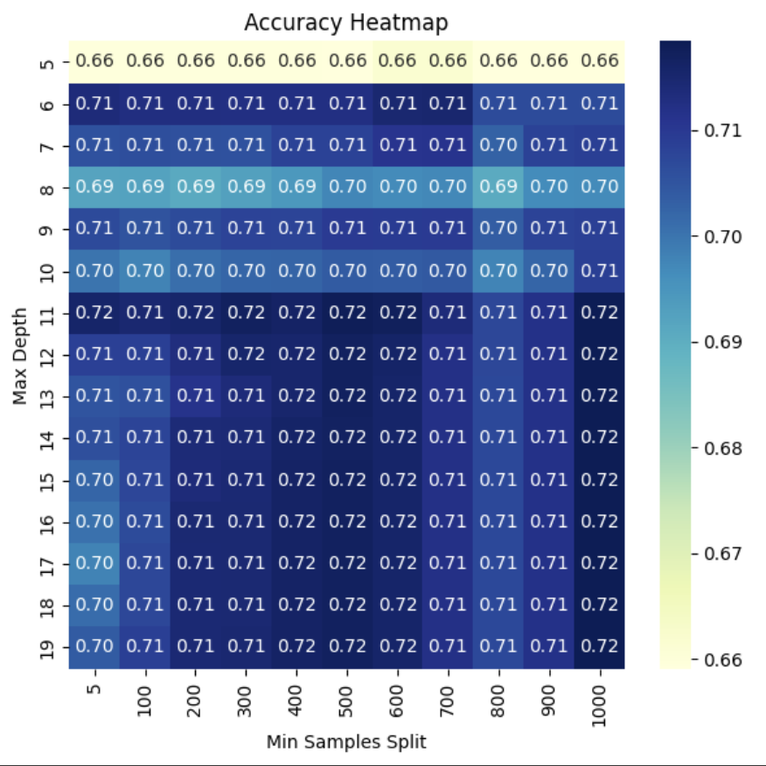
Decision Tree Accuracy
Predicting Non-Violent Ranged
EF1 - EF2
Best Hyperparameters
Max Depth: 17
Min Samples Split: 500
Best Metric
Accuracy: 0.72
Notes:
We Started off By Looking at Decision Trees to get a idea of where the models could perform the best in terms of Accuracy
A max depth at 5-6 performs the best for accuracy
The Min Samples split Does not have a effect (I am going to play around with this)

Slide 14
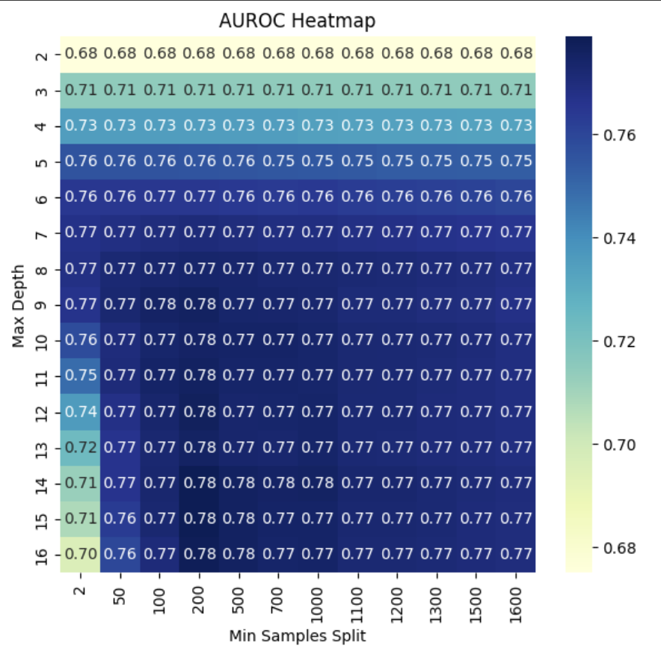
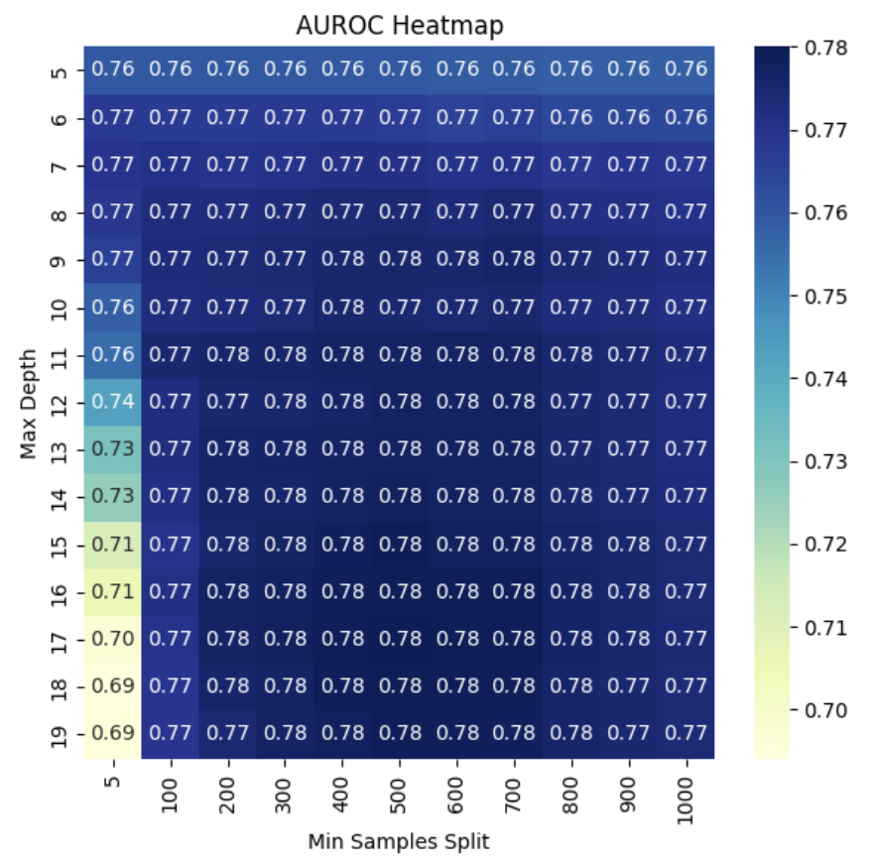
Decision Tree Auroc
Predicting Non-Violent Ranged
EF1 - EF2
Best Hyperparameters
Max Depth: 17
Min Samples Split: 500
Best Metric
AUROC: 0.78
Notes:
We Started off By Looking at Decision Trees to get a idea of where the models could perform the best in terms of Accuracy
A max depth at 5-6 performs the best for accuracy
The Min Samples split Does not have a effect (I am going to play around with this)

Slide 15
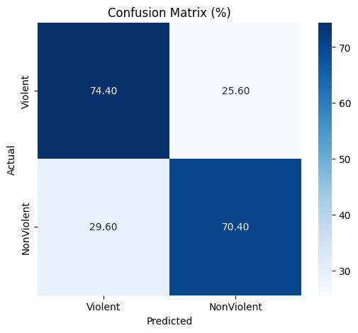
Gradient Boosting
Predicting Non-Violent Ranged
EF1 - EF2
Hyperparameters Used
Max Depth: 17
Min Samples Split: 500
Metrics
Accuracy: 0.73
AUROC: 0.80
Notes:
Using the data provided from the decision trees, we can use the hyperparameters similar in the decision tree to make this model perform better.
Model Info Already Listed

Slide 16
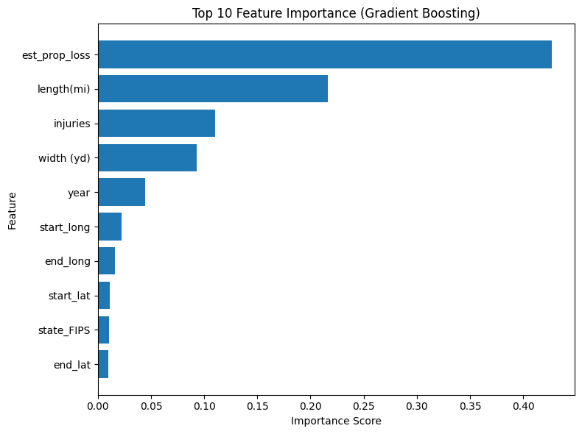
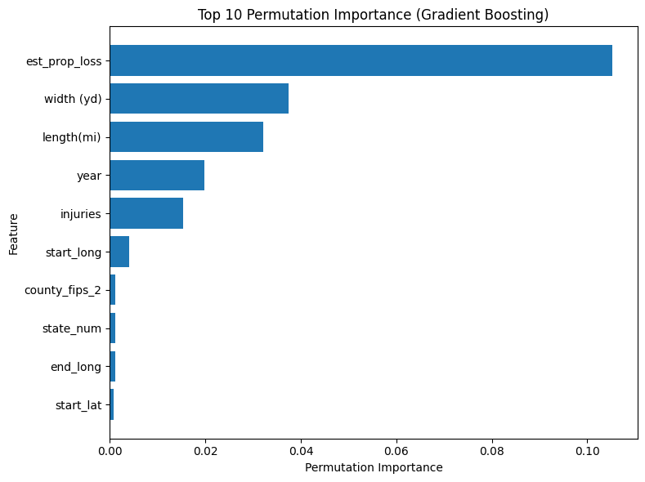
Gradient Boosting Features
`
Permutation
Measures how much the model’s performance degrades when feature values are randomly shuffled (permuted).
Notes:
Using the data provided from the decision trees, we can use the hyperparameters similar in the decision tree to make this model perform better.
Model Info Already Listed

Slide 17
Predicting Violent Tornadoes
EF3 and EF4 Ratings
Notes:
Note again the violent tornadoes are e3 and e4

Slide 18
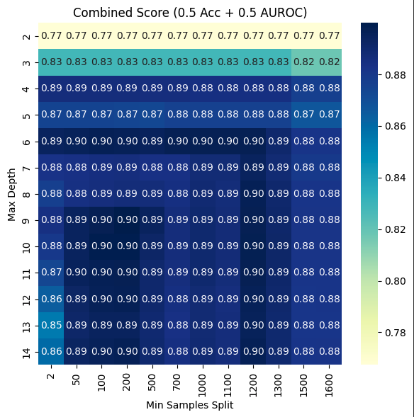
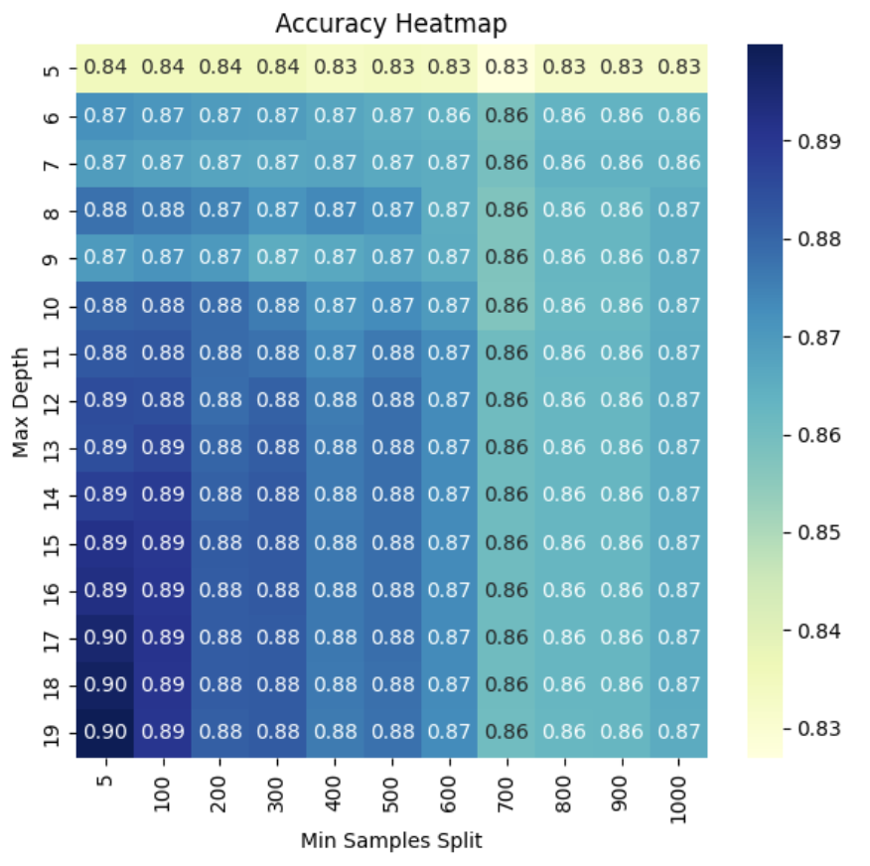
Decision Tree Accuracy
Predicting Violent Ranged
EF3 - EF4
Best Hyperparameters
Max Depth: 10
Min Samples Split: 100
Best Metric
Accuracy: 0.88
Notes:
We Started off By Looking at Decision Trees to get a idea of where the models could perform the best in terms of Accuracy
A max depth at 5-6 performs the best for accuracy
The Min Samples split Does not have a effect (I am going to play around with this)

Slide 19
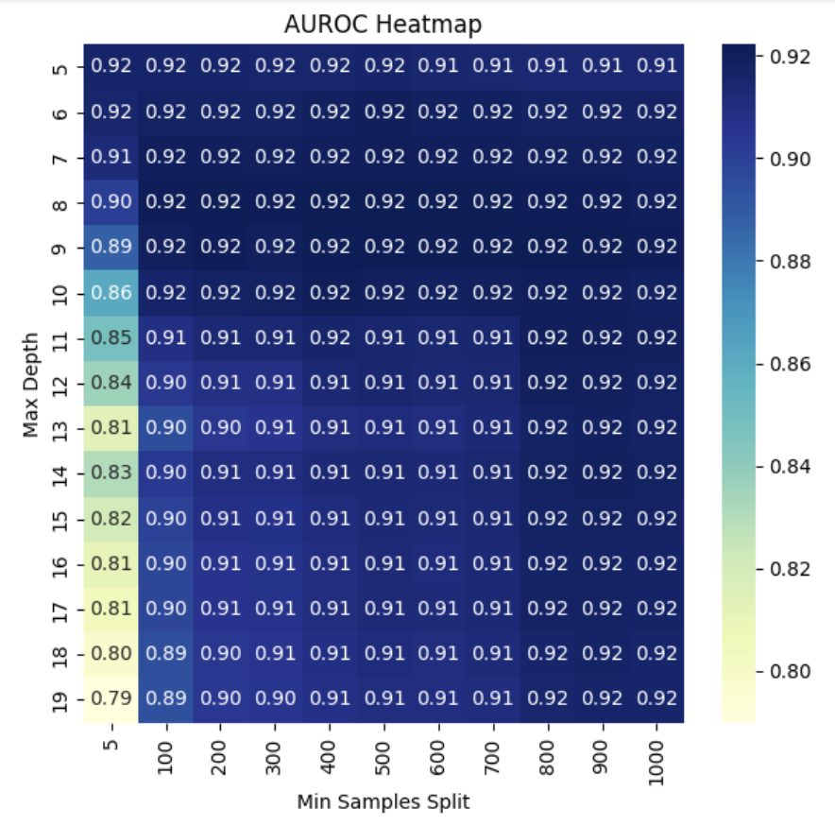
Decision Tree Auroc
Predicting Violent Ranged
EF3 - EF4
Best Hyperparameters
Max Depth: 10
Min Samples Split: 100
Best Metric
AUROC: 0.92
Notes:
We Started off By Looking at Decision Trees to get a idea of where the models could perform the best in terms of Accuracy
A max depth at 5-6 performs the best for accuracy
The Min Samples split Does not have a effect (I am going to play around with this)

Slide 20
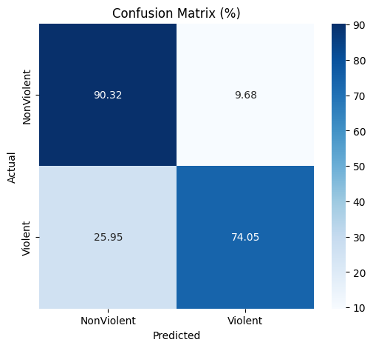
Gradient Boosting
Predicting Violent Ranged
EF3 - EF4
Hyperparameters Used
Max Depth: 10
Min Samples Split: 100
Metrics
Accuracy: 0.89
AUROC: 0.93
Notes:
Using the data provided from the decision trees, we can use the hyperparameters similar in the decision tree to make this model perform better.
Model Info Already Listed

Slide 21
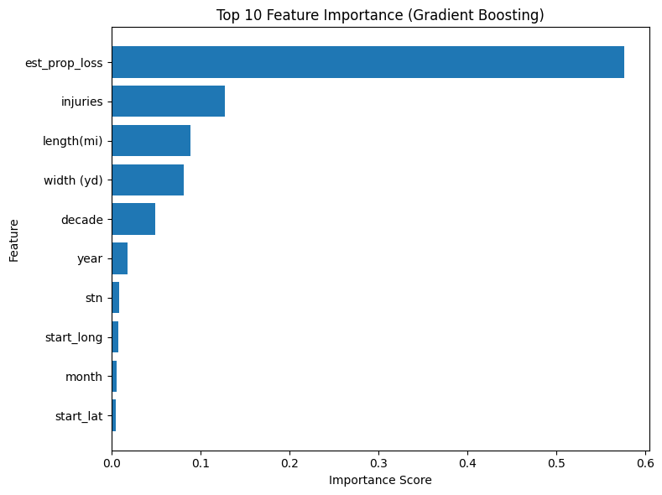
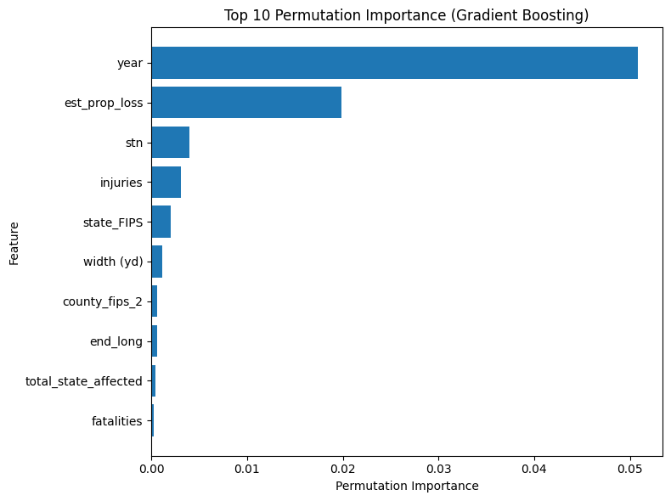
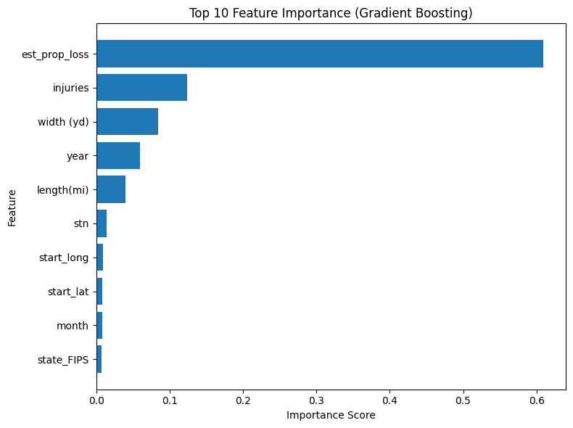
Gradient Boosting Features
Mismatch?
Features are what the models uses to split the data and reduce impurity
Permutations show what's important to the model

Slide 22
Modeling Takeaways
Models are predicting tornadoes with 73% - 89% accuracy
Predicting EF1 - EF2 Tornadoes (in order)
Property Loss
Length (mi) / Width (yd)
Year
Injuries
Predicting EF3 - EF4 Tornadoes (in order)
Year
Potentially Climate / Technology Related
Property Loss
State Number / State FIP
Which State the Tornado Took Place In
Injuries
Notes:
What we want to add here what it looks like when we take out the year and which type of tornadoes our model does a good job of predicting
What we find is that while our model is more accurate in predicting violent tornadoes, it is less certain about it as we have seen with the permutations. What this means is that it is picking up on a trend not seen in the non violent tornadoes, leading to an increased accuracy. This seems to suggest that violent tornadoes have more moving parts within the prediction that make it more

